Slide 1
THE BEST TEAM WINS Turn Hiring and Retention Into a Source of Competitive Advantage
KEVIN BAUMGART
VP | Hireology
773.220.6035 | kbaumgart@hireology.com | Chicago, Illinois
Notes:
Thank you
Next 90 minutes
Goal - takeaways - things you can act on in your store next week

Slide 2
The Big Opportunity
Where should dealerships be looking for competitive advantage and increased unit economics?
Source: Driving Sales
Notes:
we found that there is a great opportunity for dealerships to better compete and improve unit economics in their stores.
Through focusing on people.
Data from last year - entire US

Slide 3
Today’s Agenda
The Talent Ecosystem
The Super Elements
Hiring Process
Millennials – your new workforce
Career Branding
Onboarding

Slide 4
Mounting Challenges In Automotive Retailing
Growing Top-Tier Dealerships
Marketing
Interest Rates
Variable Operations
Capitalization
Fixed Operations
Training & Development
Service
OEM Programs
F & I
Legal & Compliance

Slide 5
The Problem
Most Managers Are Really Bad At Hiring
People are the number one cost for dealerships
75%
Hiring the wrong manager can put a dealership behind
The cost of replacing a bad hire is between
3 and 10x
compensation
of dealers report trouble with hiring
six
months
Notes:
Way it’s always been. ¾ of dealerships report that they are bad at it and struggle with it. People are the top cost and it can get really expensive and distracting if you get it wrong.

Slide 6
Talent Ecosystem
Strong Employment Brand
Strong Culture
More/Better
Applicants
Better Leaders & Managers
More/Better
Hires
Notes:
Reveal
Step through steps in the process
Where do I start – If I as a dealers hire better people but crappy manager they leave. Chicken and egg problem. If I were you, this is the right path to follow. Starts with your employemnt brand. One thing that you can do today, that can really impact people.
Just like consumer marketing process.
Spend a lot to opt into buying from you.
Have to do the same thing
Same milllenniall car buyer
When you build this, you get more higher quality leads
Then reveal – more higher quality leads – sell more cars
More quality h
Something interesting happens when you hire better people
You find out what managers are strong
Good people won’t work for bad managers
Then your curlture gets better
Can’t do all of this at once
Start with an employment brand.
I’m going to take you through the front end of this process and how better branding leads to better to hires. \

Slide 7
What is the best predictor of job performance?
Integrity tests
Cognitive ability tests
Reference checks
Emotional intelligence tests
Job experience
Personality tests
Notes:
Start by talking about the selection process and hiring and then dive deeper into building out that career brand.
Start with some data and analysis that HBS ran on the effectiveness of hiring the right people. Surveyed hundreds of companies and HR professionals and this is some of what they found.

Slide 8
Measuring what matters
Multi-measure tests
.71+
HIGHER
Cognitive ability tests
.65
Integrity tests
.46
Reference checks
.26
Correlation
Emotional intelligence tests
.24
Personality tests
Up to .22
Job experience
.13
LOWER
Notes:
Spend time here!!!
What I know you want is a single use silver bullet test that is going to tell you with 100% accuracy on if Kevin will be a 20 car a month guy. Eveyone is looking for this majic test. Like, have you been in the car business, great – that’s the worst.
Or testing if they are a D
Go up the scale
Really only
Give IQ tests to hire the right peole = no research shows right way to do this.
Do all of these things in a multi measure test.
Best prediction is to do all of these – this is not a one shot process – it needs to be followed measured and held accountable. Success requires commitment to follow.
ALL OF THESE THINGS – not one of these things
Harvard Business School study of hiring
Interviecwd HR pjrofessionals
15 years of experience
Moral of the story is no one knows how to do this – don’t feel bad

Slide 9
Size of Entry level U.S. Labor Force
(In Thousands)
22,366
20K
21,617
21,285
Entry Level Labor force
Age: 16-24 Years
18,462
10K
-4.8%
-13.3%
1992
2002
2012
2022

Slide 10
Risk Assessment

Slide 11
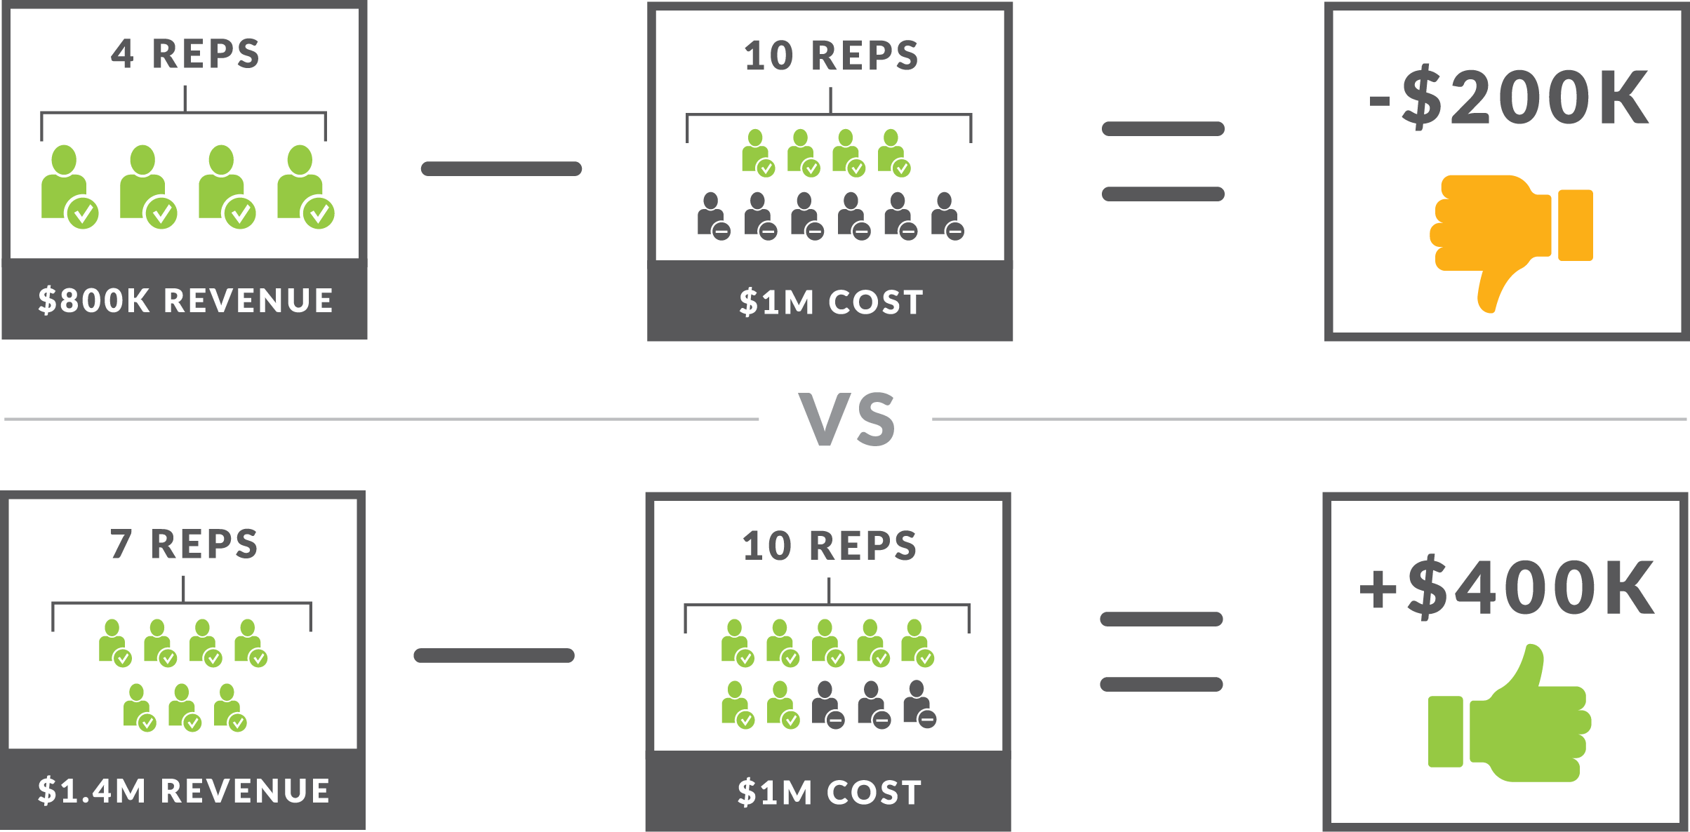
Poor Hiring Results Are Expensive
Notes:
If hiring rev producers think of the return
If hiring 10 reps and have this cost – 4 work out =- you are losing money
If get it right 6 or 7 times out of 10 you are generating profit on sales heads
He takes it out some times…
TAKE IT OUT IF IT’S CONTROLLERS!!!
ITS NOT EASY but commit to doing it and CAN REALLY HAVE AN IMPACT

Slide 12
Dispelling a myth
Our research has shown that 50% of the factors predicting a person’s success or failure in a new role…
has absolutely nothing to do with their experience.

Slide 13
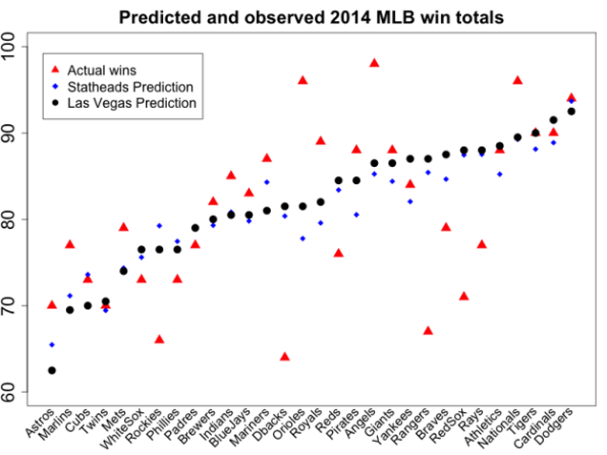
What matters?
Notes:
You’ve seen this before
FICO scoring and predicting default rates
Works in Sports – industry was built on scouts – but different things matter
All systems do is taking scored inputs to prove results.
If you start looking for these 4 things your hiring results are going to improve.

Slide 14
The Super Elements
Attitude
Sense of Accountability
Prior Related Job Success
Culture Fit

Slide 15
The Super Elements
1
Attitude:
a positive disposition, or satisfaction that persists across job experiences
Notes:
1. Most frustrating thing that happened to you - or why leaving?
Research shows that people who have a positive disposition to work overwhelmingly outperform people who have a negative or no disposition to work. You like it you will do it better right.
Other interesting research on identical twins – any twins in the room? Anyone have twins? Twins are pretty incredible – exact genetic replicas. So if you find lots of pairs of twins you can run all kinds of crazy experiments. And control for the genetics. So get this… University of MN over 2 decades…
So screen for attitude. Pretty simple. If I’m interviewing you I would ask you the question, what’s the most frustrating thing that happened to you in your last job?
Or seems like things were going pretty well, why are you leaving?
Good answer = It’s a tough place to work or it was going well management change – my time to go, learned a lot, great experience, time for the next thing
Bad answer = oh my god, you know how Bob is. That guy is a jerk, nobody wants to work for that guy, get me out of this place. Those guys don’t know what they are doing, they can’t run that store. That’s what they will be saying about you and your store 6 months later.
Positive attitude, leads to higher likelihood of better work and better fit. You need not have to have car experience to ask someone this. It could be volunteering. It could be just in life. When is the last time you were frustrated, what was going on. Listen to the language. It was frustrating but I made the most of it = good answer. It was frustrating and those people are horrible – not a good answer.
Ok. Onto number 2

Slide 16
The Super Elements
2
Sense of Accountability:
The extent to which a person believes he or she has control over their own outcomes, also called “locus of control”
Notes:
when was the last time you set a goal for yourself that you didn’t meet or achieve?
internal locus of control will say things to you like, I should have done a better job understanding what was expected of me, I should have asked better questions or it was a holiday weekend, I didn’t watch my staffing levels, I let a couple people take off, I’m sorry that’s my fault. Vs.
An external locus of control that didn’t hit goal - the economy is bad, we don’t have the inventory we need, financing killed my deals. They are excuses and nothing has to do with me. It’s all of this other stuff happening to me. People with an internal locus of control have a 40% higher likelihood of being top performers. 40…
So ask them, when was the last time you set a goal for yourself that you didn’t meet or achieve? Tell me why, what was going on there.
I this, I that - you are probably talking to someone who owns it.
Those guys, they – probably not
This works on family members and children too and by the time they are 12 it’s pretty much baked….

Slide 17
The Super Elements
3
Prior Related Job Success:
Having met formal goals in past jobs that are similar to the job at hand
Notes:
What were you accountable for, how was performance measured, where did you rank on the team?
Ok, Prior related job success. It doesn’t matter what the job was it matters that the performance was measured. So if you are hiring someone from outside of this industry, try your best to hire people who worked in jobs where their performance was measured. Vs. people who worked in jobs where it wasn’t. It doesn’t mean that someone who’s performance wasn’t monitored or measured isn’t going to be a good fit. Just means over the long run if you hire more folks where performance is measured you will be better off. What does measuring performance mean. Go into any Starbucks. They are happy but they get the snot measured out of them. From customer walking in, to coffee waste to point of sale throughput to timing to hours. Starbucks barista is one of the most measured people in your neighborhood. Hyper managed role and they love it. People that work in that environment and like it, you want in your store, why? Because it’s all about monthly targets. If someone is not used to monthly pressure, not saying don’t want to hire them. Just saying that the risk of them not being able to hack it just went way up.

Slide 18
The Super Elements
4
Culture Fit:
The degree to which the candidate shares similar values with the organization,
and demonstrates an authentic interest in the job at hand
Notes:
Finally culture fit. This one can get a little squishy.... So Culture fit is less about plaque that is in the stores lobby and more about your value system as a manager. So the best way to understand what my value system is as a manager is to do an exercise from Jim Collins (Good to great, built to last, etc.) Approach called Mission to Mars. Goes something like this. We have discovered life on Mars. Big news. Your dealership, your store has been selected to send one employee on this most important mission of humankind – first contact. We have one opportunity to get this right. Which person on your team do you pick? Can’t be you. Who do you send? Got a person. Now, make a list of all the reasons why you picked that person. They are on time, they are consciences, work hard, service minded, etc. Come up with that list. Guess what – that is a list of your values as a manager. Those are the things you value and when you hire someone into your team that might be great at what they do but not in the way you value it, that is when you can get into trouble. If you value loud arm waiving, pacing, constant motion kind of selling, you are doing to value that kind of Product Specialist. If you don’t value quiet, methodical, research based highly prepared before the person comes in selling that would appear less urgent but really isn’t then that person is going to drive you crazy even if they hit numbers. Know what you value. And if you are looking to cut your risk of making bad decisions hire into the culture that you have defined into your brain.

Slide 19
Hiring is a process, not an action
Profile the role
Source candidates
Pre-screen
Scripted and scored interviews
Reference check
Testing and assessments
Verification
Notes:
Here’s what the new process looks like.
Before we post a job and create a job description and spend a lot of money with careerbuilder, monster, etc. we need to take time to profile the role, most importantly analyzing and defining the outcomes of the role.
Then we need a good pool of candidates, sourcing is important.
Then we put them through a defined, structured and scored interview process
Finally, we are going to verify everything that we have heard throughout the process
Dive into each of these more.

Slide 20
So how do you land top-tier GenY talent?

Slide 21
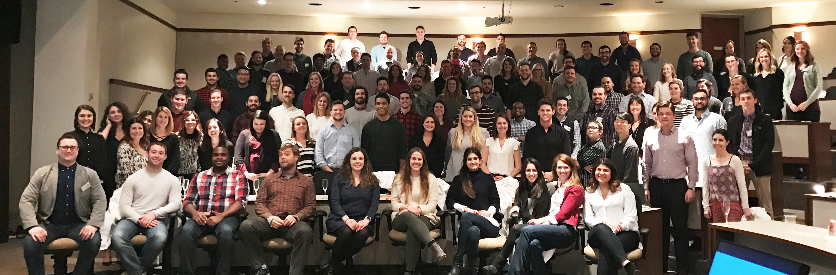
Let’s Talk
Generations

Slide 22
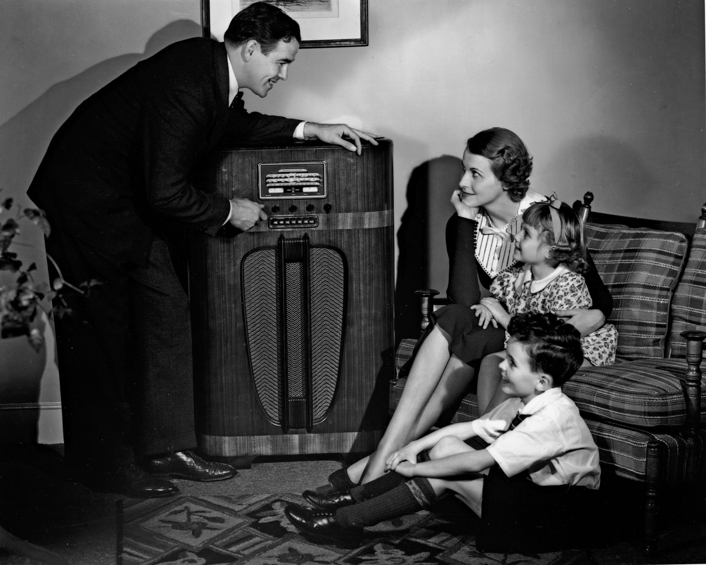
TRADITIONALISTS
Notes:
We are going to do a quick walk through of the generations as we talk about what it takes to bring these next generation hires into your store.
Traditionalists came of age in the 40’s and 50’s – also called the Greatest Generation. Largely out of the workforce now. Single low digits as a percentage of the workforce.

Slide 23
BABY BOOMERS
Notes:
Baby Boomers – (Think I see a few of you in this picture…) as a Gen Xer, these are my parents. Came of age in the 60’s and early 70’s. have been the dominant workforce in America since that time. They run the stores they are the major employee percentage at dealerships. This is no longer going to be the case shortly.

Slide 24
GEN X
Notes:
This is Gen X. This is our CEO Adam Robinson and I am in this bucket as well. We are the smallest generation. Born between 69 and 80ish… depending on who you ask. We are the smallest generation but we are now inheriting the world. So, we are inheriting this from the boomers…. There aren’t that many of us… We are sandwiched in by baby boomers and millennials… We are not going to last long – because there aren’t that many of us.
So there aren’t enough of us to fill all the jobs vacancies that the boomers are leaving.
So…. meet your new workforce…..

Slide 25
GEN Y
Notes:
We have taken pictures of actual millennials – these are not stock photos. These are real life millennials in the wild. They work in our company and we hire about 100 of them a year. These are 3 actual photographed in the wild millenials.

Slide 26
52% of all new hires were Millennials last year
Gen Y now makes up 33% of the dealership workforce

Slide 27
MEET THE MILLENNIALS
Notes:
This is your talent pool. Are you ready for this talent pool?
Who thinks they are ready for this? Who thinks they are doing well but can improve. Who has a long way to go?
Let’s review some data on millennials and how they FEEL. Cuz they talk about that a lot right….

Slide 28
ON OPTIMISM…
“How confident are you that if you work hard, you will be able to build a comfortable life?”
Confident! 80%
Doubtful… 12%
Not sure 8%

Slide 29
RIDIN’ THE GRAVY TRAIN?
“How much financial support do you receive from parents or family members?”
None! 55%
Some help 28%
Major support 10%
Not sure 7%

Slide 30
But it’s a really nice basement…
According to the US census,
15% of US residents aged 25
to 34 were living with their
parents.
up 10% from 30 years earlier

Slide 31
WHAT ABOUT DEBT?
“How would you describe your current debt situation?”
No debt 32%
Struggling 27%
Managing 41%

Slide 32
$28,400
7 in 10 seniors (69%) who graduated from a four-year university have student lean debt averaging $28,400 per borrower.
Increasing $600/year, on average

Slide 33
ARE YOU LIVING THE DREAM?
“Do you feel like you are moving closer or further away from your dreams?”
Closer 75%
Further 18%
Not sure 7%

Slide 34
ON RETIREMENT…
“When do you expect to retire?”
Before 65 34%
65+ 59%
Not sure 7%

Slide 35
LOWERED EXPECTATIONS
“Do you expect to have a better standard of living than your parents?”
No – 47%

Slide 36
Gen Y is :
Optimistic about their prospects
Launching later
Carrying debt
Feeling like they’re in control of their destiny
Expect to work hard, but need to be inspired

Slide 37
How do you land top-tier GenY team members?

Slide 38
What does this generation value?
Career growth potential
No visibility into career progression
Pay stability
Heavy commission jobs
Customer Service
Flexible work hours
Long hours, nights and weekends

Slide 39
Your Dealership’s Job Descriptions

Slide 40
Your Dealership’s Job Descriptions
Does it highlight the opportunity?
Why is your dealership an employer of choice?
What benefits do you offer?
What will the candidate need to have done and do?
Notes:
Career or employment branding on your website is critical. We need to look at the careers or employment section of our sites and ask…

Slide 41
My job description:
Park cars.
Wash cars.
Get yelled at.
Work early mornings, late nights, weekends and major holidays.

Slide 42
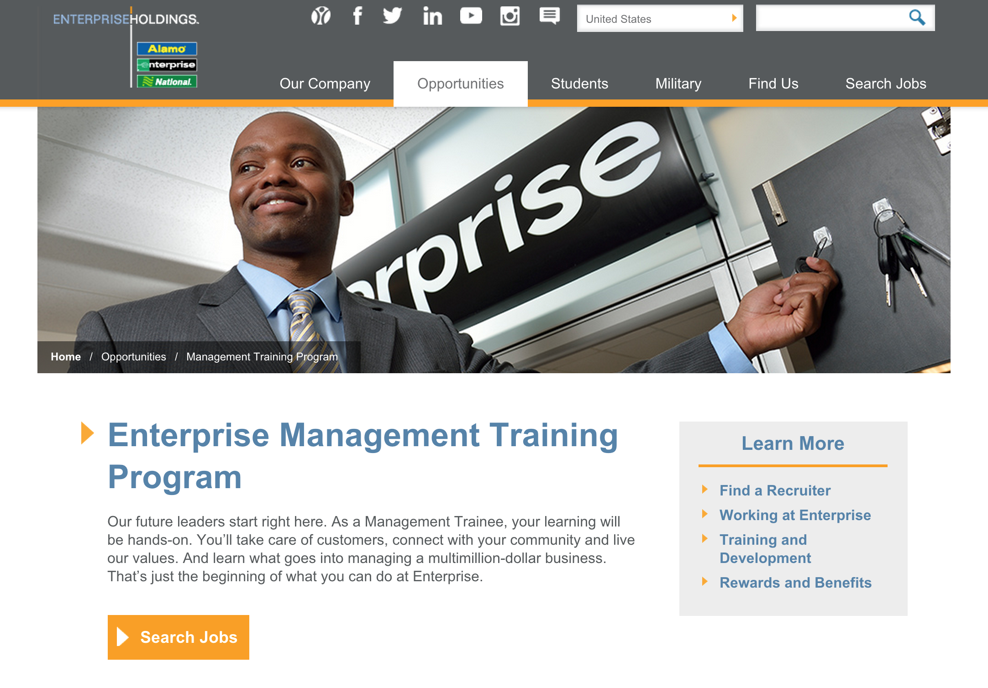

Slide 43
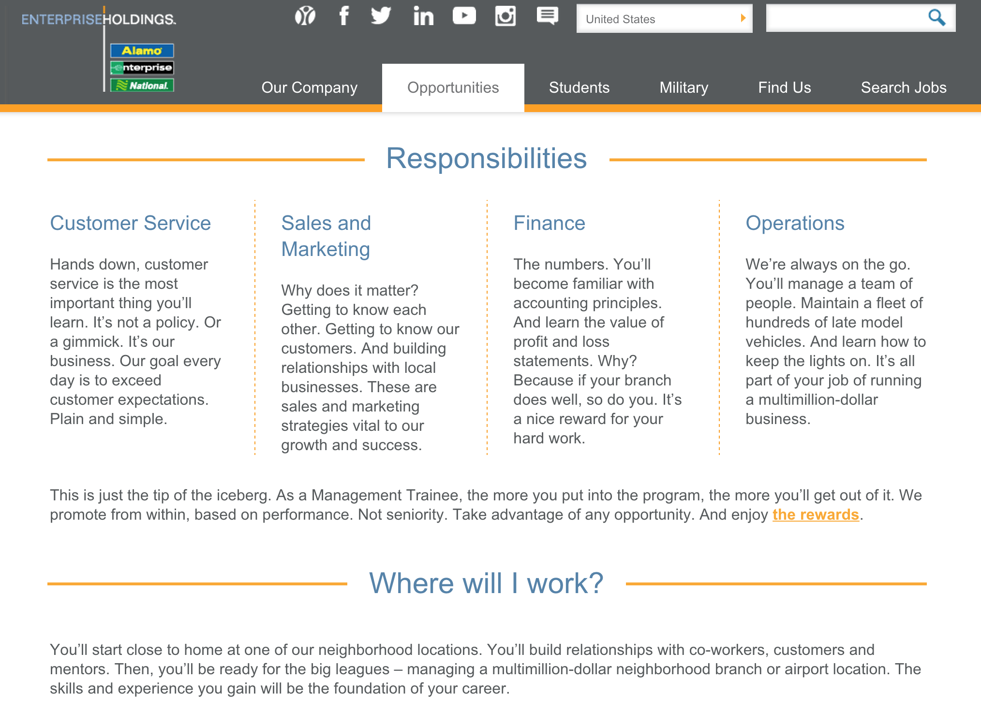

Slide 44
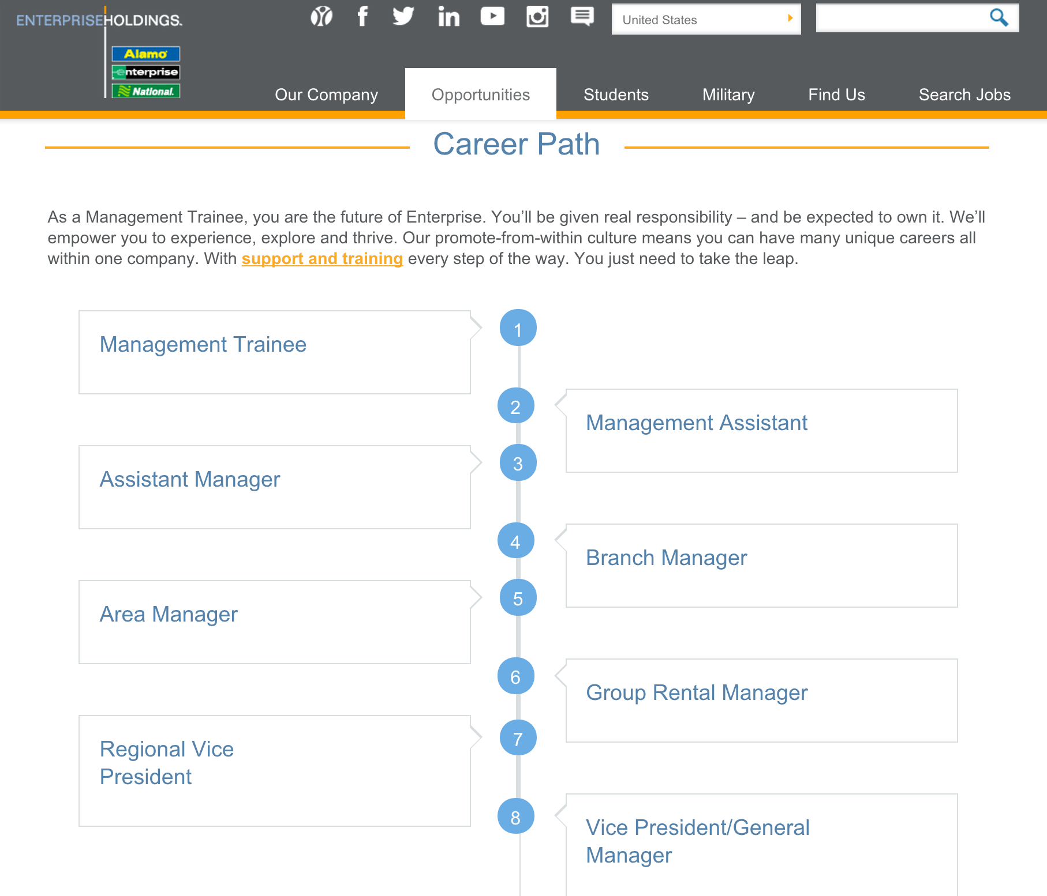

Slide 45
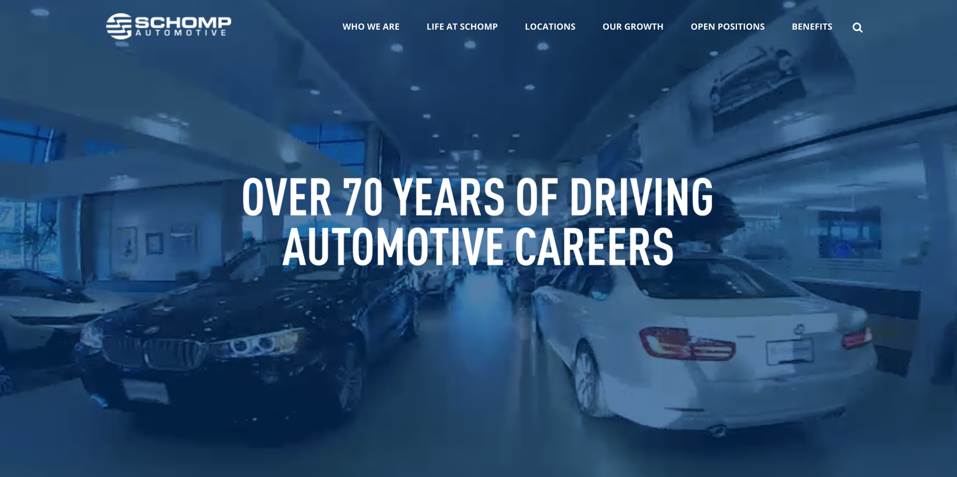

Slide 46
Recruiting is Sales and Marketing
It’s the
same person!

Slide 47
Your Dealership’s Career Site
Questions to ask to yourself:
Does is deliver the WIFM?
Is it Mobile-Friendly?
Is it easy to send in a resume or application?
Is it search-engine friendly?

Slide 48
Quick Activity
Get out your phone
Try to apply for a job on your dealerships career page
Notes:
Insert activity slide – get out phone. in 2 minutes or less apply to a job on your own dealership website.
Bonus points if you have a career page
Not a recruiting problem
Marketing technology and funnel problem

Slide 49
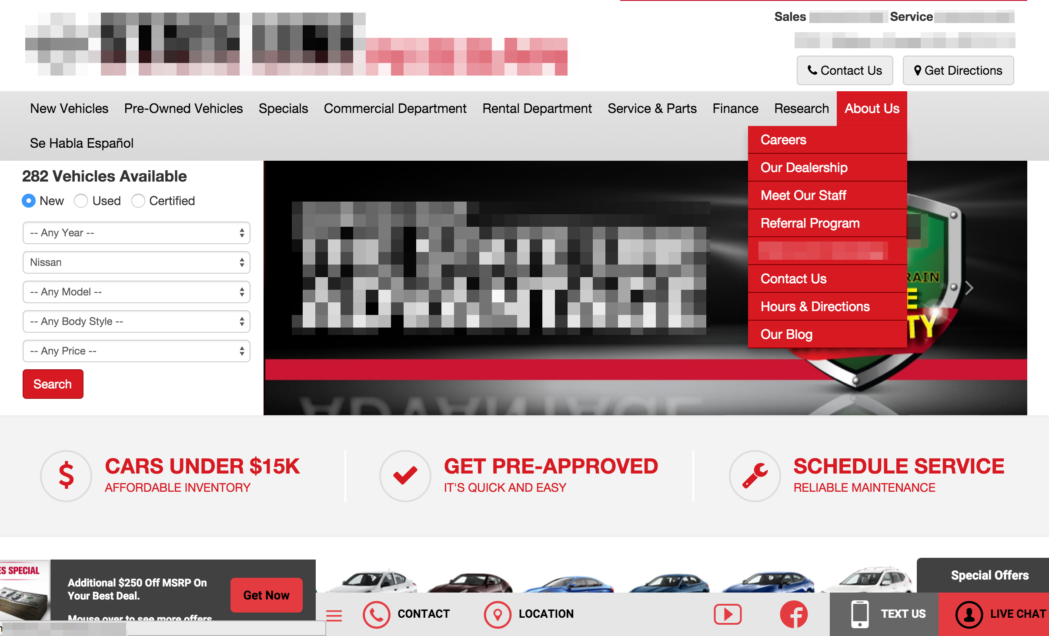

Slide 50
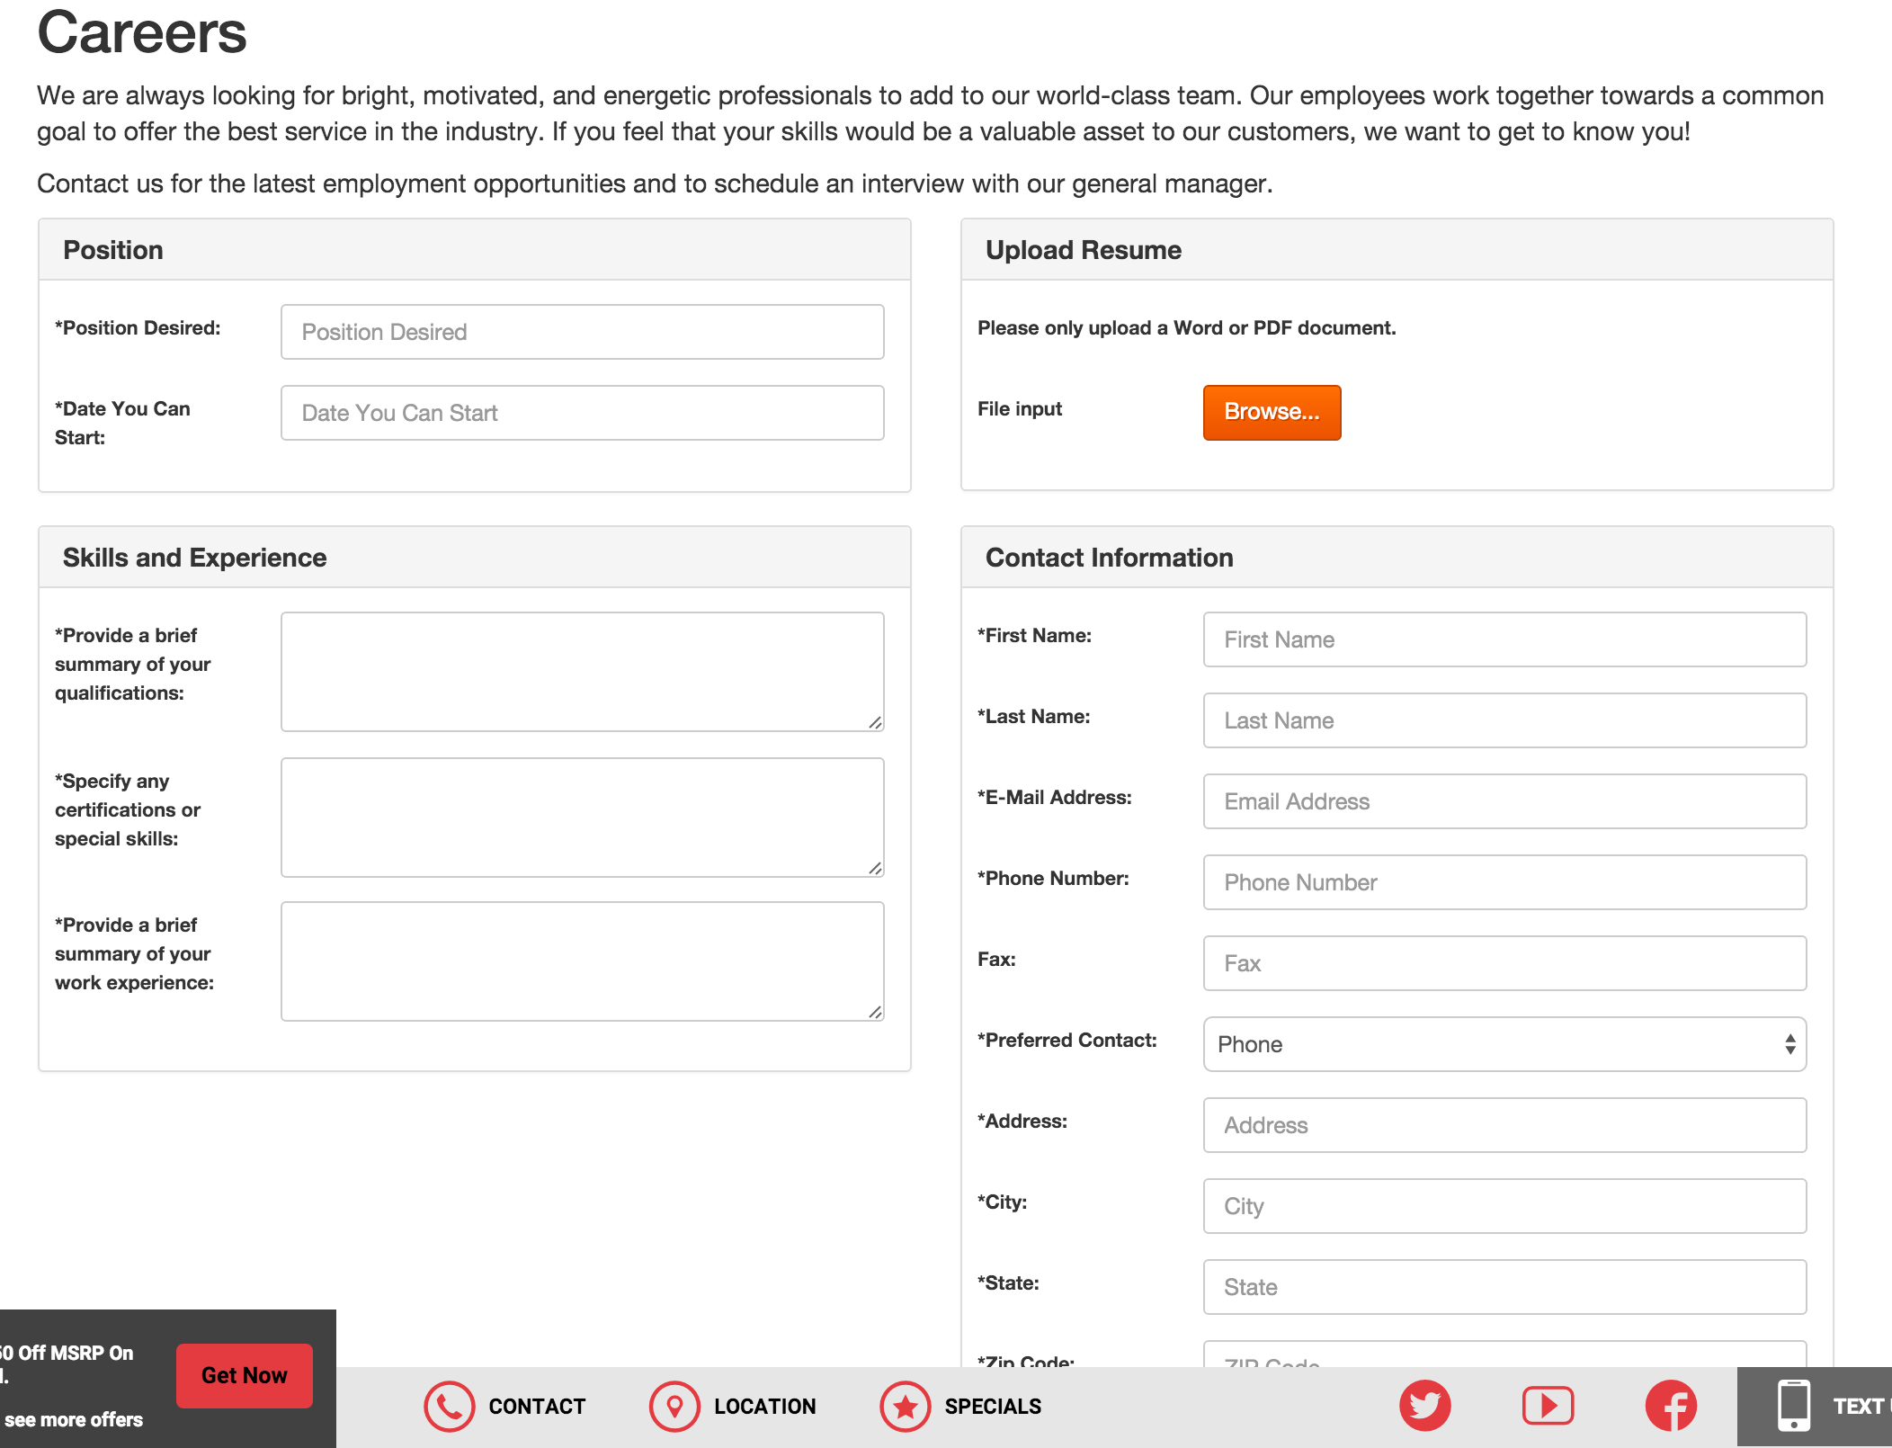
Not mobile friendly
17 minutes to submit an application
Zero WIFM
No SEO

Slide 51
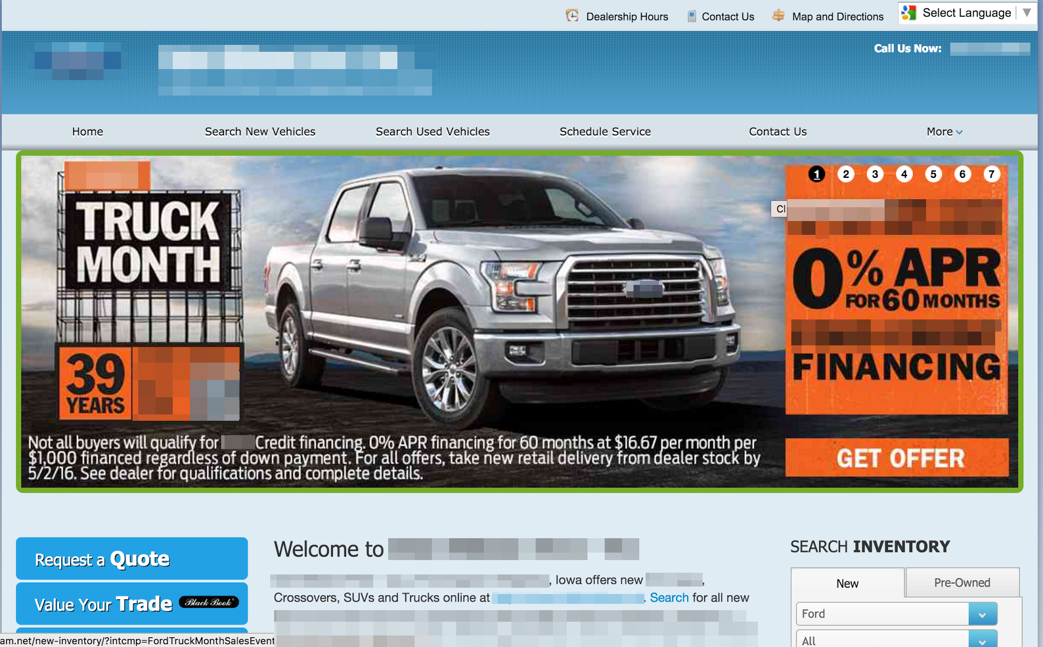

Slide 52
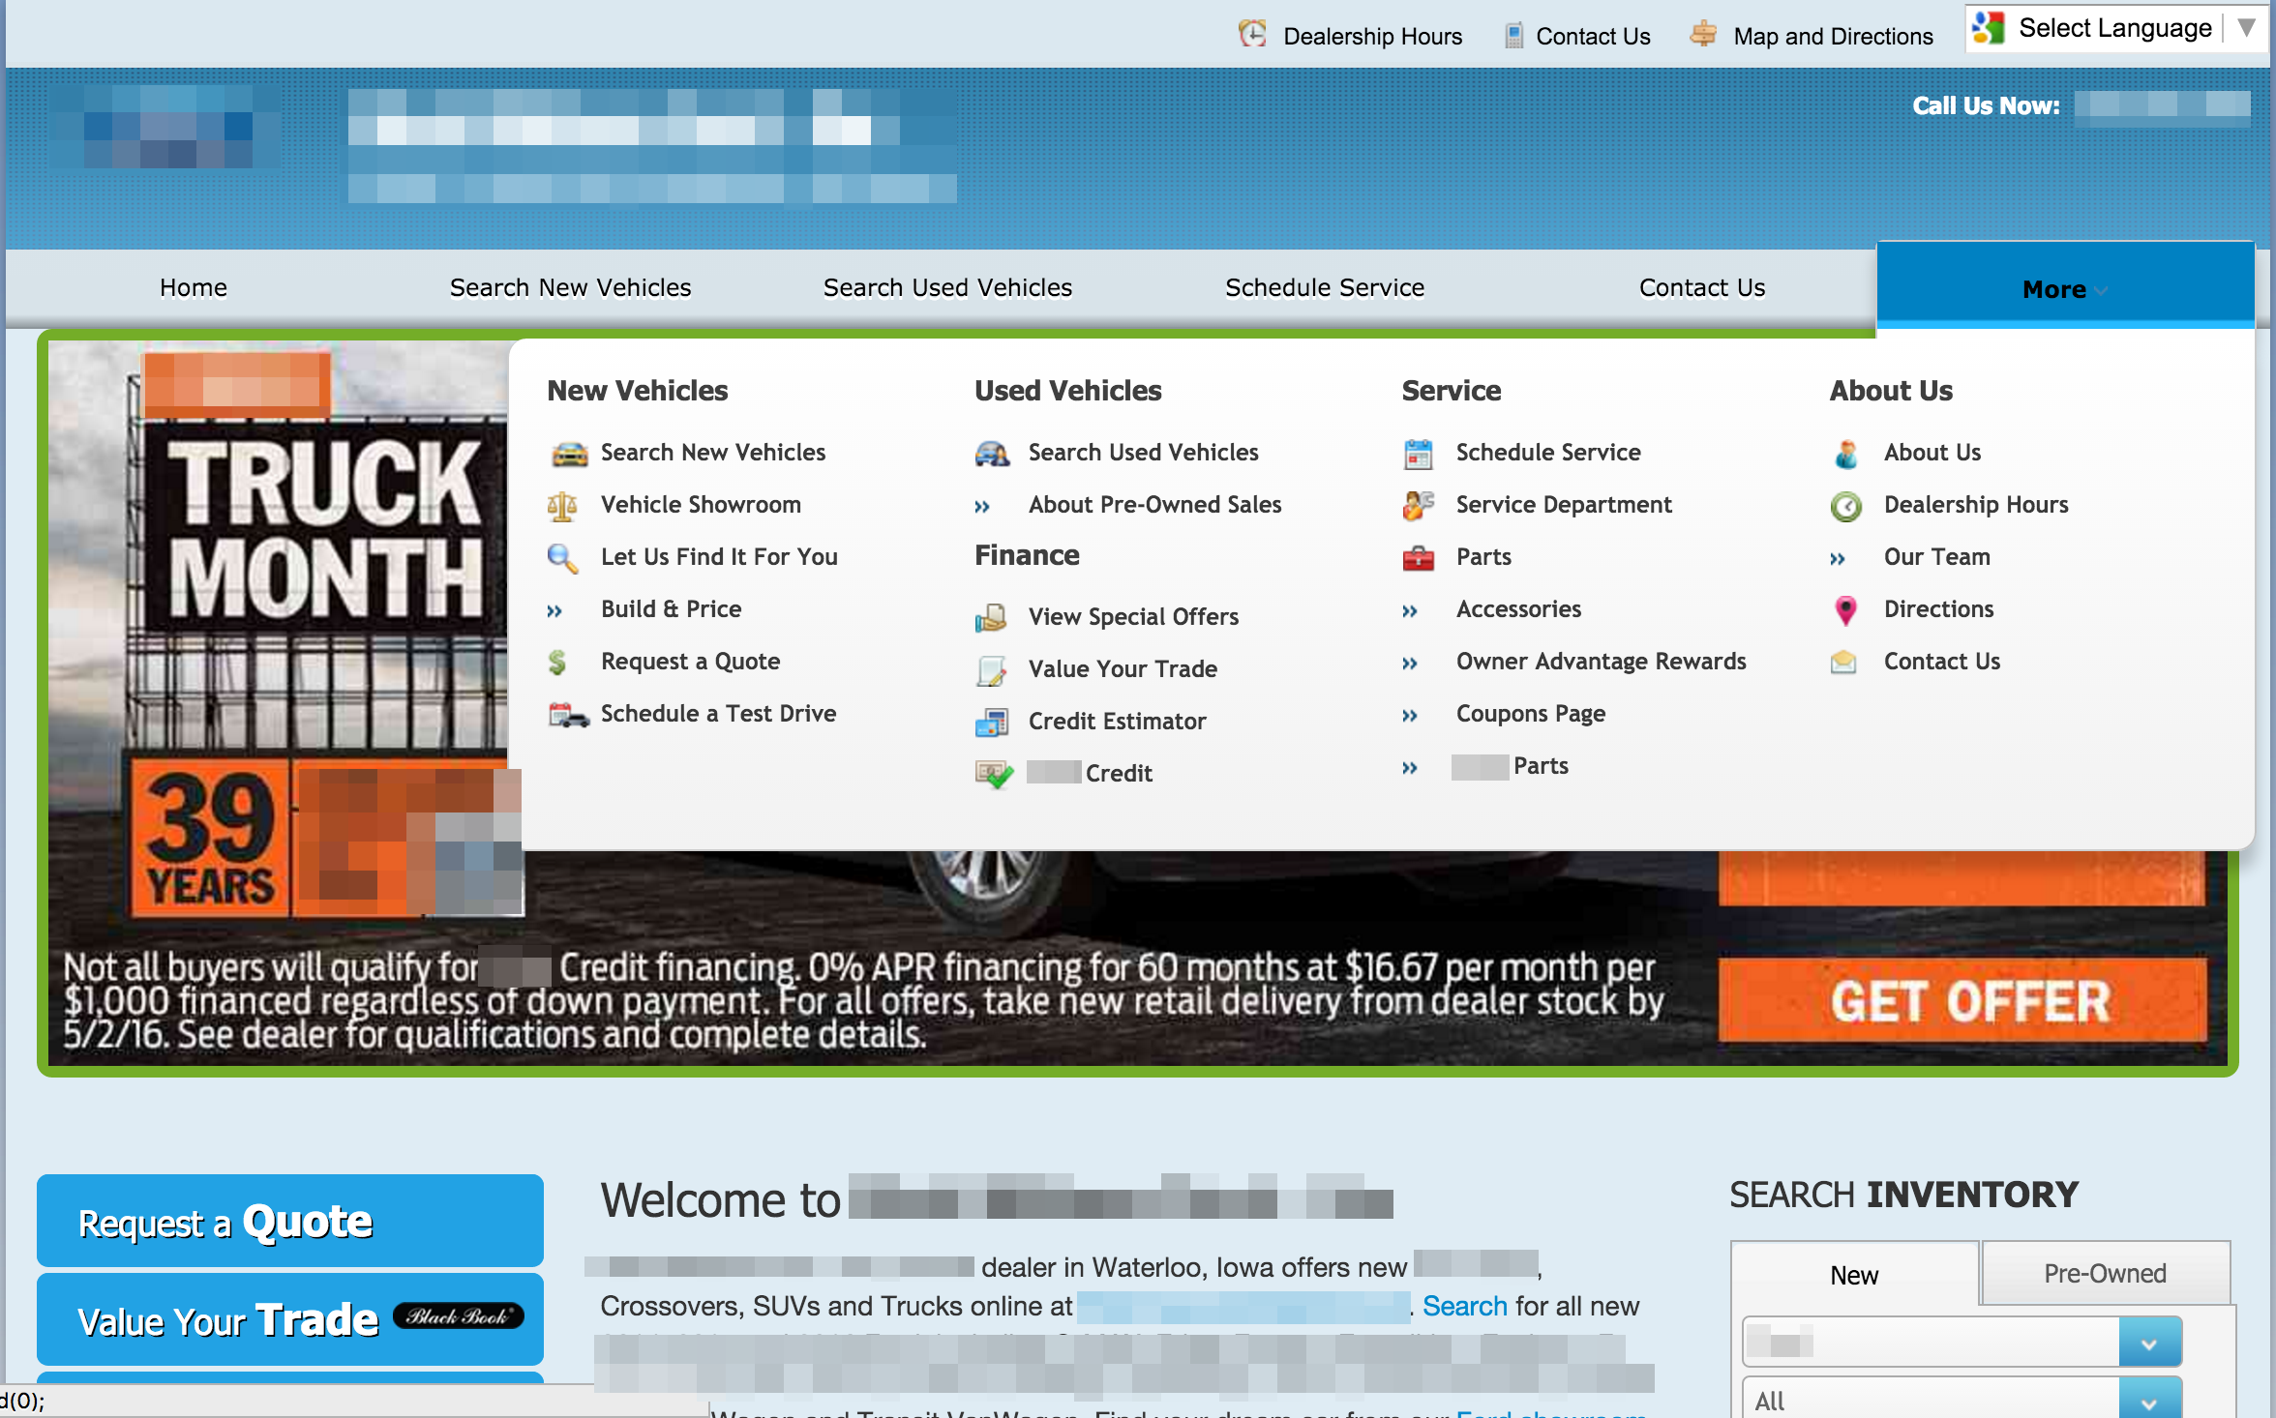
No career site
“If you can figure out how to apply, you’re in!”
Good luck!

Slide 53
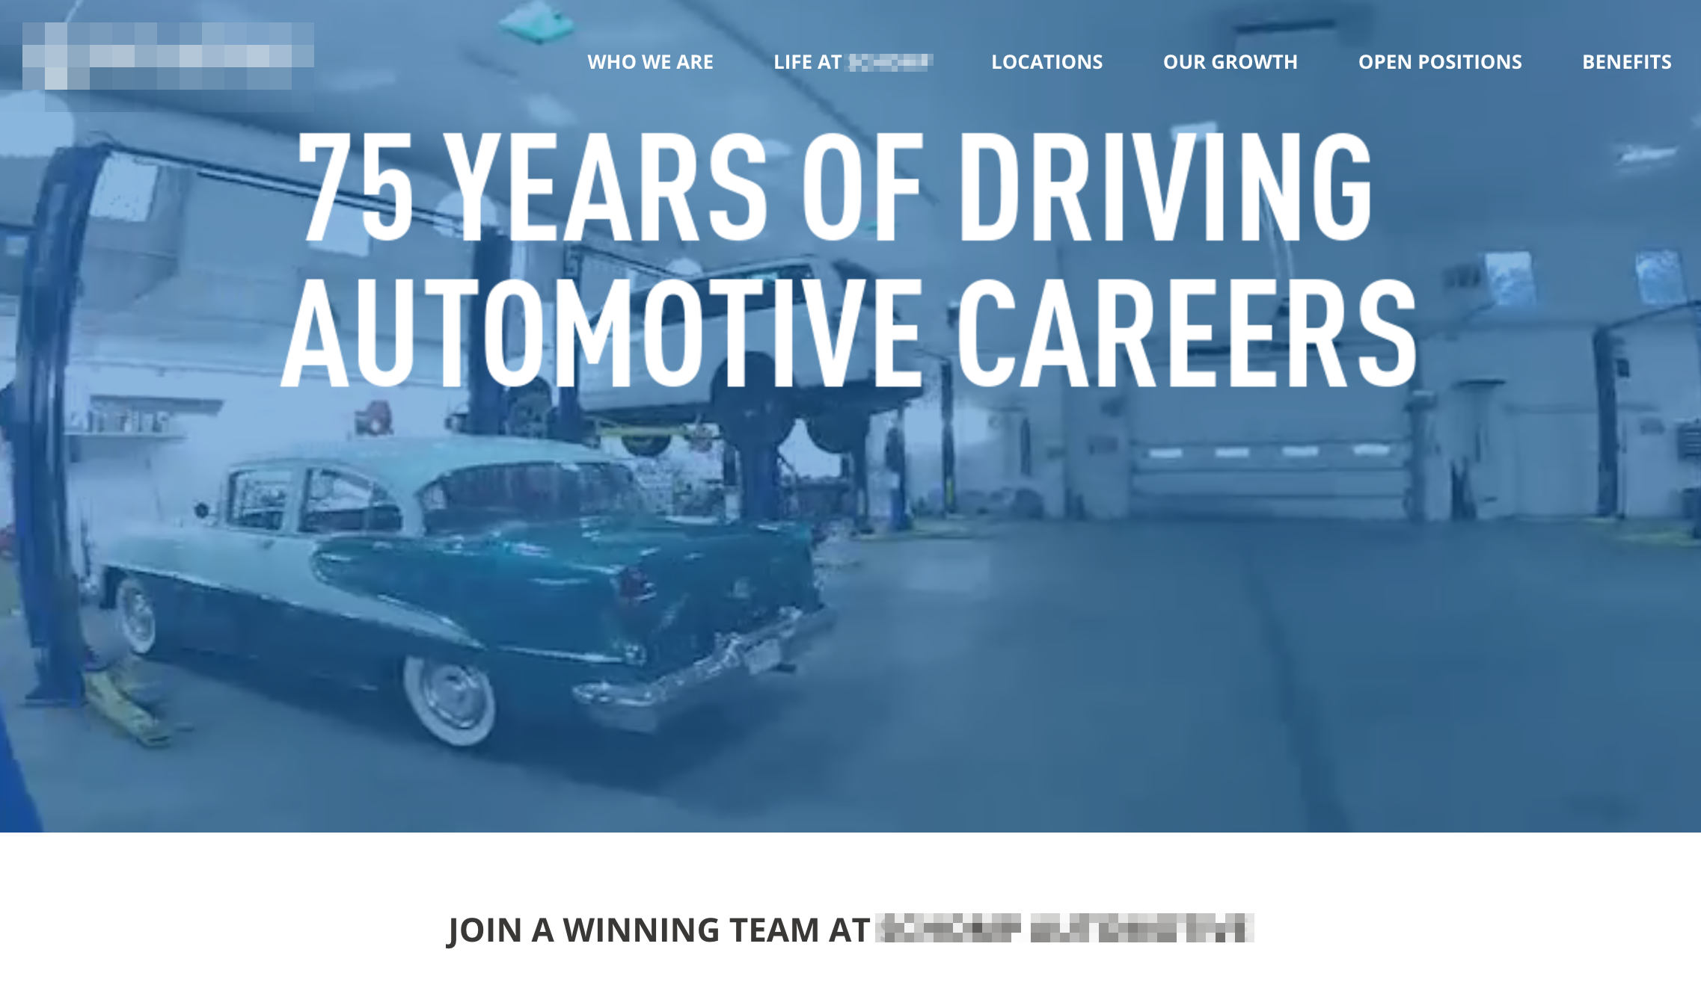
careers.dealersite.com
Mobile friendly
<1 minute to submit an application
Whole lotta WIFM

Slide 54
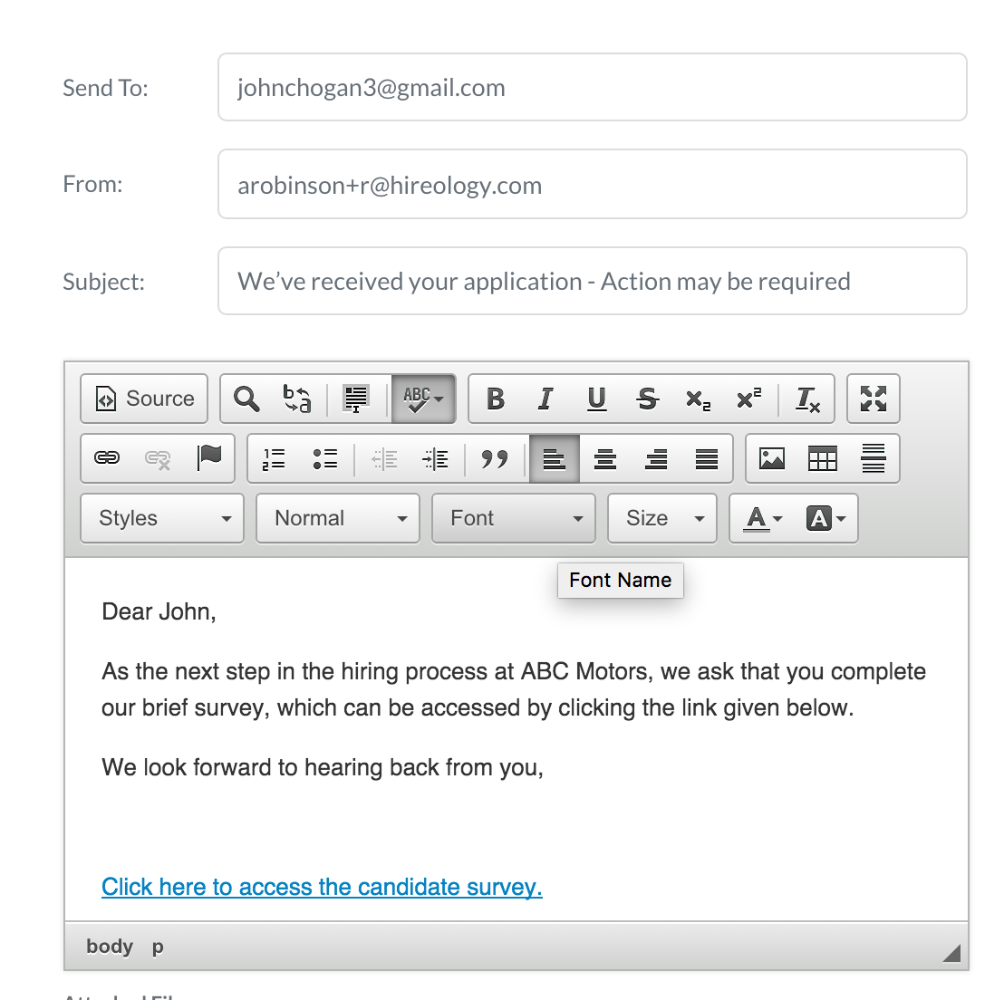
Process
Immediate response
Next action is on the lead

Slide 55
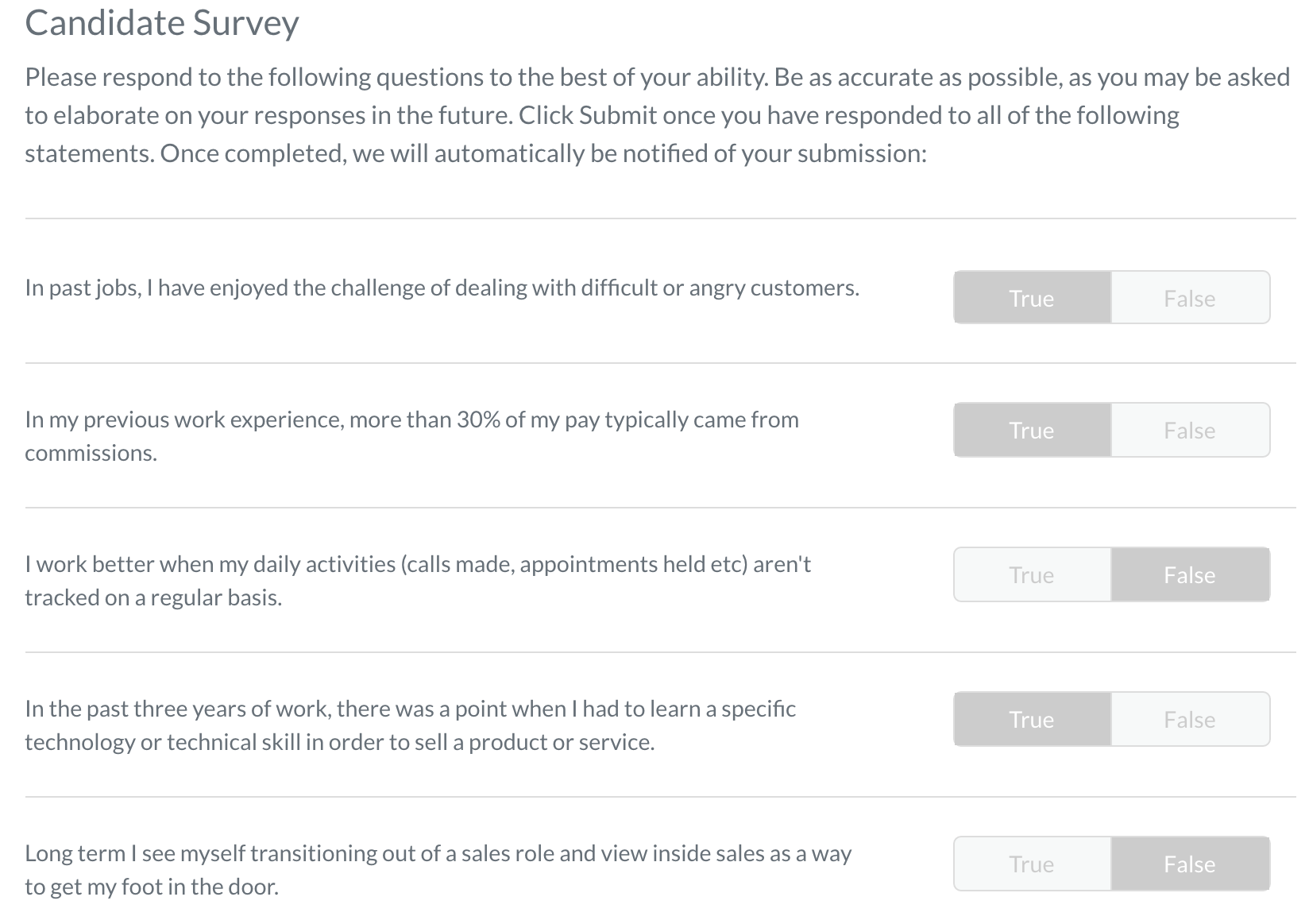
#Process
Targeted questions
Scores the lead
Shows their commitment

Slide 56
The Insight
Strong employment branding, when combined with a data-driven hiring process, is one of the best investments a dealership can make.
Strong Brand + Predictive Hiring Process = Better Results

Slide 57
The Results Six Rooftop Control Group – Mid-Atlantic
0.2%
6.1%
22.7%
11.5%
93.8%
77.3%
Source – Hireology

Slide 58
The Results Six Rooftop Control Group – Mid-Atlantic
25%
70%
75%
13%
Source – Hireology

Slide 59
The Results Three Rooftop Control Group – Midwest
1%
18%
29%
13%
82%
71%
Source – Hireology

Slide 60
The Results Three Rooftop Control Group – Midwest
30%
70%
70%
21%
Source – Hireology

Slide 61
What’s the Value?
Organic applicant traffic + process is >5x more cost-effective
Organic Cost Per-Hire: $245
3rd Party Sources Cost Per Hire: $1700
Organic applicant traffic + process yields majority of hires
20% of the traffic yields 80% of the hires
Hires sourced this way are 2.5x more likely to be an A or B player
Hires sourced this way have higher retention rates
27% versus 67% industry average
Source – Hireology

Slide 62
Add it up! For a 55 employee store:
OLD WAY 37 turns @ $16K each $592,000
NEW WAY
14 turns @ $16K each
$224,000
PROFIT ADD-BACK: $368,000
Notes:
This is what they found:
Way less expensive to hire folks this way – spend less on job board postings
Organic (meaning from the dealer career page) traffic plus having a set process yields the most hires
Hires made following this approach are 2.5X more likely to be A or B players (define A or B player as someone at 75% or more of production and job efficiency)
Hires made following this approach stay – way higher retention

Slide 63
The Insight
Strong employment branding, when combined with a data-driven evaluation process, is one of the best investments a dealership can make.
Strong Brand + Predictive Hiring Process = Better Results

Slide 64
Onboarding
DEALERSHIP
A
Which Dealership Are You?
DEALERSHIP
B
Notes:
A: new hire shows up with no one expecting them, doesn’t know where they should go. Ultimately waits in the lobby of the store for a while.
shown to conf room with no windows fill out 3 hours of paperwork
Shown to desk where they get thrown into the mix with no real training – or told to follow Jim around for a day, he knows what he’s doing
It’s a scramble to get all of their logins and technology/software stuff set up
30 days after they start no review or analysis on what they have done or if hitting goals, etc.
B: All of the needed pre-hire paperwork is done in advance
When get to desk everything laid out for them. Biz cards, company shirt, gift card, welcome card signed by all team members
All the logins are set up in advance
Structured training/onboarding
30 60 90 day review etc.

Slide 65
5 Onboarding Best Practices That Save Time & Money

Slide 66
5 Onboarding Best Practices that Save Time & Money
Customize your onboarding process for each position
62% of companies that have a solidified onboarding program experience faster
time-to-productivity with 54% claiming to
have better employee engagement
5
Notes:
Managers need to be on the same page and understand this process and be bought in. Like anything it needs to be taught and trained and they need to be held accountable.

Slide 67
5 Onboarding Best Practices that Save Time & Money
Eliminate your paper-based process
An offline onboarding process typically takes around 4 hours
4
Notes:
Find a way to make it easier to collect all of the needed data and make it electronic. Payroll provider probably has a plug in or solution to help.

Slide 68
5 Onboarding Best Practices that Save Time & Money
Form-Free first day:
Have employees fill out all forms prior to their first day
83 percent of high performing organizations begin their onboarding prior to the new hire’s first day
3
Notes:
Talk more in a minute about making day 1 great.

Slide 69
5 Onboarding Best Practices that Save Time & Money
Set clear goals for new hires on their first day
60% of companies fail to set milestones or goals for new hires⁴
2
Notes:
I want my new hires to have clear expectations about what they need to accomplish well before day one. This should really be communicated in the interview process. Very few dealerships we talk to use strong 30 60 and 90 day plans. I’ve got a sample template if anyone wants it. Essentially, the new hire, the manager, even the GM should all be on the same page as to what this person needs to learn and achieve the first 30 day 60 days and 90 days. It needs to be well communicated and they need to continuously follow-up to ensure we are on track.

Slide 70
5 Onboarding Best Practices that Save Time & Money
Make Day One Great
When new hires take part in a structured onboarding process, 66% of them are likely to remain with a company for longer than three years⁵
1
Notes:
Make sure their desk is set up and all of their accounts are set up
Give them a tour of the facility and show them where they put their lunch, where to put their coat, etc
Introduce them to the team!
Have their business cards ready and waiting
You want them going home to their significant other saying “what a great day….” vs. “I think I made a bad decision, they weren’t even expecting me...”
Any questions on ONBOARDING?

Slide 71
What’s possible
Walser National Delta
Female Salespeople
Post-secondary
Average Age
Gen Y Salespeople
13%
88%
32
71%
7%
15%
51
34%
2X
5X
(19)
2X
Notes:
Made a commitment to strengthen people strategy – operational effects and customer experience impact = correlation between both. This case shows that. Recruitment was the issue they were trying to solve. Outcome was:
8 units per sales person per month - 2009
15.7 units per sales person per month today
Finance PVR/back end gross improved $300/car (per vehicle revenue)
All 12 new car stores are #1 or #2 market share in their region
Every store has above average 12 month CSI

Slide 72
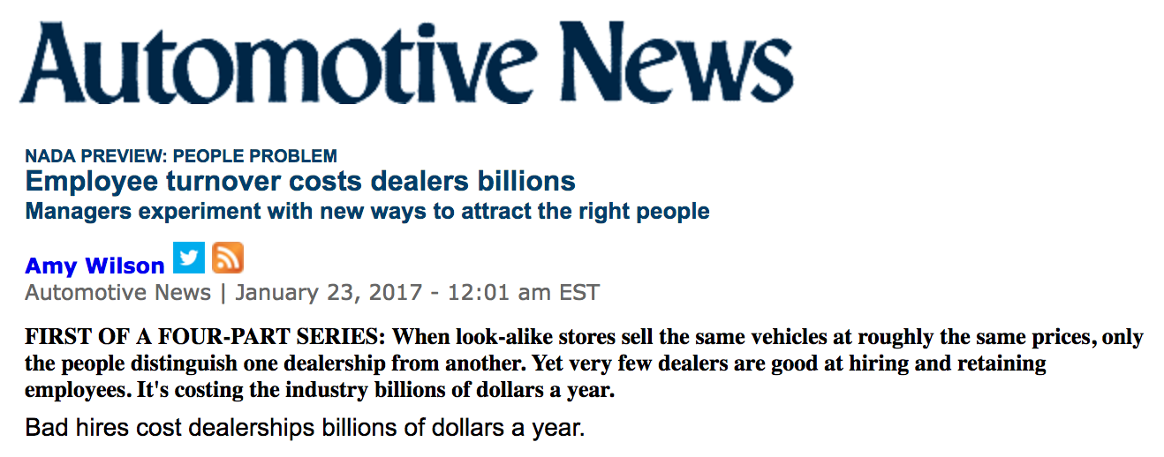
What is it costing operators?
$8 Billion
Notes:
Here’s what we don’t talk about…
Driving sales just published a report based on NADA's workforce study to show that turnover is costing the entire automotive industry $3 billion (yes billion) a year.
The financial costs overall aren’t realized. And the individual dealerships or groups aren't putting a focus on this.
They know that turnover is a challenge but they don't know the financial impact that it has on their stores.

Slide 73
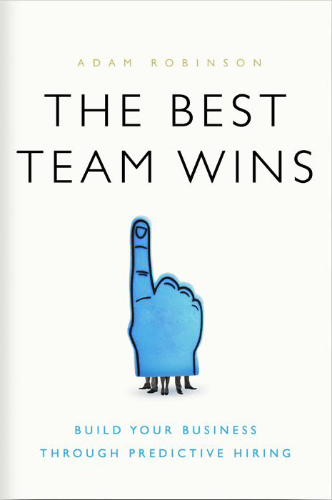
Chapter 1 Download
Read the first chapter now!
visit :
resources.hireology.com/thebestteamwins

Slide 74
THE BEST TEAM WINS
Turn Hiring and Retention Into a Source of Competitive Advantage
KEVIN BAUMGART
VP | Hireology
773.220.6035 | kbaumgart@hireology.com | Chicago, Illinois

